Slide 1
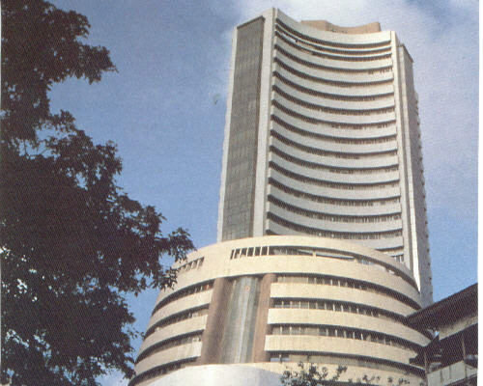
Stock Exchange Sub-Function
Operation
Stock Exchange Sub-Function

Slide 2


Agenda –
Important Terminologies
Features of Mutual Fund on Exchange
Benefits
NJ Offering
Flow Front-end & Back-end
Brokerage Processing
Future developments

Slide 3
PMS - Registration
PMS - Registration
Stock Exchange Sub-function Organogram
Vinayak Rajput
(Operations Head)
Yusuf Saunasath
(Sub-function Head)
Urvish Bhutwala
(Transactions)
Sufiyan Shaikh
(Registration)
Dhaval Shedge
(Registration)

Slide 4
PMS - Registration
PMS - Registration
Important Terminologies
Stock Exchange : A Platform where buyers/sellers are placing their orders. In India there are 2 main Stock Exchange Bombay Stock Exchange (BSE) & National Stock Exchange (NSE)
Member: An entity/individual who is registered with Exchange and is authorized to send transactions to exchange. NJ is the registered member of BSE & NSE
Depository: An organization which holds the investor's (BO) securities in electronic form. Namely there are 2 depositories CDSL and NSDL in India.
Depository Participant : A Depository Participant (DP) is described as an agent of the depository. BO has to open an account with depository to avail its services through a registered DP. They are the intermediaries between the depository and the investors. NJ is the Depository participant of CDSL
SEBI : Security & Exchange Board of India (SEBI) is the regulartor for the Security market in India .

Slide 5
PMS - Registration
PMS - Registration
Important Terminologies
AMC : Asset Management Company (AMC) is an investment management firm that invest the pooled funds of the retail investors in the security market.
RTA : Registrar & Transfer Agent (RTA) are the agents appointed by the company/AMC, who maintains the records of the investor's transactions.
Segment : The securities are distributed under various segments such as Cash, Debt, Derivative (F&O), Currency, Commodity, Mutual Fund on the Exchange platform.
Trading Account: Investor account registered with Member for giving transaction instructions which are to be routed through Exchange.
DEMAT Account : DEMAT account is an account where client securities/units are maintained. Demat account is opened with Depository through its Depository participant only. DEMAT account is like a bank a/c. Bank account has cash, DEMAT a/c has securities.

Slide 6
PMS - Registration
PMS - Registration
Important Terminologies
Unique Client Code (UCC): A unique code provided by the Member to each client registered with them. This would be unique Identification no of the particular client
Delivery Instruction Slip (DIS): DP issues DIS to all account holders. These are just like cheque book, where the account holder can transfer units from there account to another account by filling the necessary details and submitting the same to the DP. In normal practice, POA is taken by member and DIS is given to DP by modes like physical (one on one) or by generating a file of all DIS and signing the same or through the digital mode.
Transaction Instruction Slip (TIS): This is a slip issued by NJ to all Trading account holders for giving transaction request. These are just like MF application form in a synchronized format where the account holder shall fill the investment / Transaction detail.
POA : Power of Attorney given by client to its Member to transfer units against the redemption transaction done by client. This eliminates physical submission of DIS for each transaction by client.

Slide 7
BO ID: A unique code provided by the depository for the BO registered with it. In CDSL, it's a 16 digit number where first 8 digit are DP ID and next 8 digit are client ID. Eg: NJ’s DP ID is 12064200; where BO ID would be 1206420000000011
ISIN : International Security Identification Number (ISIN) is the universal unique number for each security traded on the Exchange.
Settlement Account : Member has to open Segment-wise Exchange bank account required for Payin.
Client Account : Member has to open Client account with each bank where the client fund is received.
CM Pool Account: Member has to open Exchange-wise Member pool account for payout with both CDSL & NSDL.
PMS - Registration
PMS - Registration
Important Terminologies

Slide 8
PMS - Registration
PMS - Registration
Roles -
Role of Exchange : To facilitate its members to route the client transactions on its platform.
Role of Member : To place the client orders on Exchange, maintain all the records in its back-office
Role of DP : To transfer units to the individual clients as per the instruction received from the Member. To execute clients request for transferring units from 1 DEMAT to other DEMAT account
Role of RTA : To process client transaction received from Exchange/AMCs & maintain records.

Slide 9
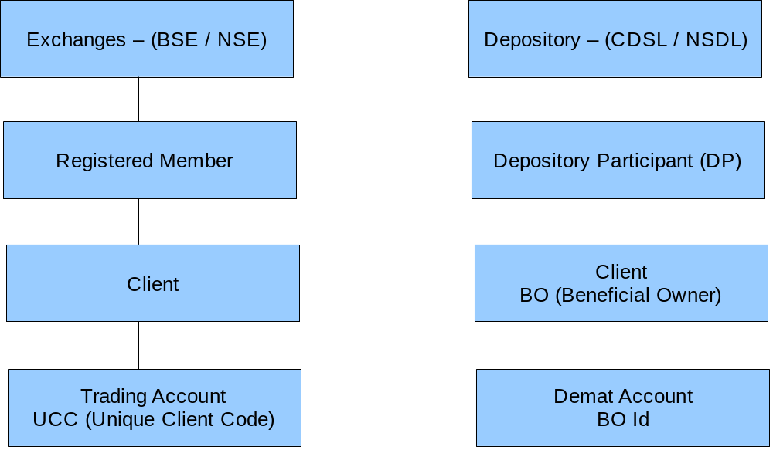
PMS - Registration
PMS - Registration
Trading A/C Graph Demat A/C - Graph

Slide 10
PMS - Registration
PMS - Registration
Difference in Cash & Mutual Fund Segment
CASH SEGMENT
Buyers & Sellers are available.
Trade takes place real-time & price flucuates every second.
Settlement of shares & Funds is done on T+2 day by 10:30 am.
Settlement of fund is done on Net basis.
MUTUAL FUND SEGMENT
Seller could be anyone, but buyer is always AMC
Only order is placed on Exchange before cutoff. Price is released EOD called NAV (Net Asset Value)
Settlement of units is done same day by 4:30 pm & settlement of Fund is done on next day 9:30 am
Settlement of fund is done on Cross-basis.

Slide 11
PMS - Registration
PMS - Registration
Transaction Modes in Mutual Fund
Mutual Fund
Physical (Non-Exchange)
Exchange Platform (BSE/NSE)
Note :- Basic Concept of Mutual Fund Does not change only flow of transaction Changes in both the above modes.

Slide 12
PMS - Registration
PMS - Registration
Transaction Modes in Mutual Fund (Difference)
Physcial (Non-Exchange) mode
- Transactions are submitted to RTA/AMC by the client / agent / distributor.
- Units are directly credited to client.
- Units could be under DEMAT/Non- DEMAT mode
- For Redemption transaction amount is credited directly to client account by RTA/AMC
- Client signature is verified by RTA
- PIP/RED/SIP/SWI/STP are offered
Exchange mode
- Transaction could be submitted to RTA/AMC/Member.
- Member submits transaction to Exchange.
- Units are alloted to Member Pool account and after then transferred to client DEMAT.
- Units are only in DEMAT mode.
- Redemption fund is also received in Member bank account & are then transferred to actual client account.
- Client signature is verified by Member
- Only PIP/RED/SIP are offered

Slide 13


Benefits of Exchange Platform
One time documentation process.
Reduction in tedious paper work .
Consolidated Holding Statements of Stocks & all MF Schemes.
Unique flexibility to Charge Clients for Transactions done.
Reduction in queries due to high accurate transaction.
Any change in personal information gets registered with all the MF schemes in demat account.
Increases the capacity to handle high volume of transactions.
Reduction in opeartional cost.
Easy Mode of transaction.

Slide 14
PMS - Registration
PMS - Registration
Flow of Mutual Fund Transactions through Exchange
Purchase
Client submits transaction to
Member
Member confirms order
status in its back-office
Member executes the trxn
on Exchange platform (T-day)
Exchange debits member Settlement
Account for Payin (T+1, 9:30 am) &
transfers amount to AMC
Exchange submits transaction
to RTA (T day)
RTA allots units on (T+1) day
to Exchange
RTA confirms order to
Exchange
Exchange gives units on (T+1) day
to Member Pool a/c
Exchange confirms order to
Member
Member Transfer units to
client a/c on (T+1)

Slide 15
PMS - Registration
PMS - Registration
Flow of Mutual Fund Transactions through Exchange
Redemption
Client submits transaction to
Member
On receiving RTA confirmation,
Exchange update the status
on its platform
Member executes the trxn
on Exchange platform T-day
Member updates the trxn status
in its back-office
Member submits the DIS to DP
for client a/c debit before 3:30 pm
As per settlement type Exchange
receive redemption funds from AMC
DP has to execute the DIS
before 4:30 pm
Exchange credit funds to Member
a/c by 12:30 pm
Exchange checks the units in
its a/c at 4:30 pm & transfers
to AMC a/c
Member transfer funds to client
a/c by 1:00 PM

Slide 16
NJ Flow of Trading & DEMAT Account Opening (Physical)
PMS - Registration
PMS - Registration
Client submits TADA form along with other supporting
documents to Partner
Partner submits form to NJ Branch after doing IPV
CRO at Branch verifies the details & does entry in Trading Registration system
& send the form to H.O.
H.O. Executive verifies the details & does the data
entry in DP back-office software (DP secure).
Client details are exported & imported in CDSL system (CDAS).
BO ID is generated in CDSL system (CDAS).
CDAS data is again imported in DP Secure

Slide 17
NJ Flow of Trading & DEMAT Account Opening (Physical)
PMS - Registration
PMS - Registration
UCC is generated in NJ system & then Data from DP secure is imported
to NJ system on the given UCC
Client UCC & details are uploaded on BSE & NSE
Client is Activated in NJ System.
Client Wel-come kit is dispatched & online login details are emailed.
UCC ready for Transactions.

Slide 18
NJ Flow of Trading & DEMAT Account Opening (e-form)
PMS - Registration
PMS - Registration
Client submits TADA form along with other supporting
documents to Partner
Partner/NJ employee does data entry in NJ system
& also scan all the supporting documents
HO executive will verify the data entry & document & gives approval in system.
After receiving Approval, branch employee will print the e-form
& send to H.O after doing IPV
HO employee receives the documents & TADA form.
All other H.O. Process remains same.

Slide 19
PMS - Registration
PMS - Registration
NJ Offering in MF on Exchange
NJ is a leading player in terms of transaction volume generated on Exchange platform.
Transaction Modes & cut-off:
  Online
  Offline
  Call & Transact
Available Transation type -
  Purchase
  Redemption
  SIP

Slide 20

Transactions through Online Portal
Transactions through Online Portal
Online Trading - Key Features
NJ the first to provide an online platform for the Mutual Funds on Exchange.
Take less than a minute to complete a transaction
Online DEMAT Transaction & Portfolio report.
Instant email notification on registered email id on the execution of transaction.
All major AMC's available which are traded on Exchange platform.
Online Purchase / Redemption / SIP available.
Cutoff time upto 2:00 pm
HDFC / ICICI / AXIS / SBI/ IDBI / YES bank available for online purchase. We have direct tieup with HDFC/ICICI/AXIS Bank whereas SBI/IDBI/YES are offered through our service provider TPSL. Redemption & SIP facility for all clients

Slide 21
NJ Flow of Transaction (Online mode-PIP & RED )
PMS - Registration
PMS - Registration
Client logins to Trading account from www.njindiaonline.com, select the Transaction type ie Purchase or Redemption.
Purchase :
Client selects AMC, Scheme name & enters the desire amount of Purchase, after entering the details client select bank (which will be registered bank with Trading Account) & confirms the transactions. At this stage Transaction ID is generated & its status is “Wait for Reco”. Client will be directed to the Net-banking page of the selected bank & logins to the account. After making payment client will redirected to Trading Account website.
Redemption :
Client selects AMC, Scheme. Available Redemption quantity is fetched from DP secure & displayed. After entering details client will confirm the transaction. At this stage transaction ID is generated & its status will be “Pending”

Slide 22
NJ Flow of Transaction (Online mode-PIP & RED )
PMS - Registration
PMS - Registration
Transaction Processing at H.O.
Purchase
At 2:00 pm HO executive will download the bank statement of respective banks which are available for online. The bank statement will be imported in Trading Account system & reconciliation will be done. Transaction status will be changed to “Reco Done”.
After reconciliation Purchase file will be generated to be upload on Exchange (Only those transaction will be included in Exchange file for which reconciliation is done successfully) Transaction status is changed to “Processed”
Redemption
At 2:00 pm redemption file will be generated from Trading Account & uploaded on Exchange (All the Online redemption transaction will directly included in the file) Transaction status is changed to “Processed”
After generating Purchase file, Purchase Transaction which are still in “Wait for Reco” ie funds are not received are canceled in Trading Account .
Redemption DIS for POA client is submitted to DP team by 3:00 pm

Slide 23

Transactions through Online Portal
Transactions through Offline
Offline - Key Features
Offline offered in 15 cities, 49 PSC
Upto 5 transactions are allowed in a single TIS
Multiple AMCs & scheme allowed in a single TIS
Single cheque for multiple transaction in same TIS
Purchase Cut-off 1:00 pm,
Transaction upto value of Rs. 1 lakh & non-ELSS transaction processed on the same day NAV.

Slide 24
NJ Flow of Transaction (Offline mode PIP)
PMS - Registration
PMS - Registration
Partner collects the Transaction Instruction Slip (TIS), Cheque from the client.
Cheque amount will be Investment Amount+Brokerage.
Partner submits the TIS along with the cheque at the PSC before 1:00 pm
CRO will verify the client details mentioned on the TIS with the system before entering the transaction details in the system.
If all docs & details
are correct
No
CRO will inform to Partner
to get it corrected
Yes
CRO will enter transaction details in Fundztrax>>Trading Account from the TIS. System will display Total Amount= Investment Amount+ Brokerage. CRO will verify the same with cheque Amount

Slide 25
NJ Flow of Transaction (Offline mode PIP)
PMS - Registration
PMS - Registration
If details are correct ie
cheque amount
=system amount
No
CRO will inform to Partner
to get it corrected
Yes
CRO submits transaction & TAR Number is generated. CRO will scan TIS, T&C & chq & map to the respective TAR No. Transaction status is “Pending”
At 1:30 CRO will Generate the CMS slips for all transactions and deposit the cheque and CMS slip to HDFC Bank CMS branch.
On receipt of CMS acknowledgment CRO will scan the CMS acknowledgment & map to the TARNo.

Slide 26
NJ Flow of Transaction (Offline mode PIP)
PMS - Registration
PMS - Registration
Transaction processing at H.O.
At 2:00 pm at HO Executive will generate the Purchase file from Trading Account to be uploaded on Exchange.
All the Offline transactions with Amount < Rs. 1 Lakh & non-lock-in schemes will be included in the file & executed on exchange. (For Transaction value >Rs. 1 Lakh & Lock-in schemes will be executed on funds clearance in NJ Account.) At this stage transaction status at HO will be “Uploaded”
Units allotment will be done on T+1 days evening for all the transactions which are uploaded on exchange on T day irrespective of their fund status
On T+2 days cheque status is received for cheques deposited on T day, CMS report is received from bank which is imported in the Trading Account system.
If payment failed
in CMS report
Yes
Transaction status will be changed to “Cheq Return” Client will request to submit fresh cheque. Redemption will be done for the Alloted Units if cheque not received. Penalty & any losses will be recovered from the client/partner
No
Transaction status will be changed from “Uploaded” to “Process”

Slide 27
NJ Flow of Transaction (Offline mode RED)
PMS - Registration
PMS - Registration
Partner collects the TIS from the client along with DIS (in case of Non-POA),
All the mandatory fields on TIS has to filled & signed by the client
Partner submits the TIS & DIS (Non-POA) at the respective PSC before cut-off time
and it will be checked by CRO
If all docs & details
are correct
No
CRO will inform to Partner
to get it corrected
Yes
CRO will enter the transaction details in Exchange-trax. After generating the TAR No. TIS will be scanned & mapped with the TAR No. Transaction status is “Pending”

Slide 28

Transactions through Online Portal
Transactions through Call & Transact
Call & Transact- Key Features
Secured & easy mode of transaction
Available for HDFC / ICICI / Axis Bank
Mandate registration required.
Purchase / Redemption Transaction allowed.
SIP registration allowed.
Line open from 10:00 am to 2:30 pm
Dual authentication done by IVRS & agent.
Purchase transaction amount gets debited through Direct Debit mode after 3:00 pm
Transaction amount upto Mandate limit provided.
Call & Transact to be made available to all clients ie TPIN will be generate for everyone. PIP will be offered only to registered banks.

Slide 29
NJ Flow of Transaction (Call & Transact)
PMS - Registration
PMS - Registration
Client will call on Call & Transact Number <0261 3987500>
IVR will ask caller to enter his/her UCC & TPIN (for first level verification)
If entered UCC
matches
No
Maximum 3 attempts will be allowed, after that client will be informed & call will be disconnected by system.
Yes
Call will transferred to the NJ Call center Agent, he/she will verify client's personal details such as Client Name, DOB, Mobile number, email ID.
If details give
are correct
No
Client will be request to call again with correct details
Yes

Slide 30
NJ Flow of Transaction (Call & Transact)
PMS - Registration
PMS - Registration
Under recorded phone-line transaction given by client on Call will be placed in NJ system by Agent Before confirming the transaction, order details will be verified by Agent to the client. Transaction ID will be given to client. Before ending the call, client will be intimated about the brokerages charges & the total amount which will be debited from his/her Bank account through Direct Debit mode
Transactions received upto 2:30 pm will be executed on Exchange by NJ.
At 3:00 pm Payment Collection file for purchase Transaction will be generated & uploaded on respective bank through net banking
Status of funds is downloaded from bank & uploaded in NJ system.
Payment Success
Transaction rejected in NJ & Exchange
No
Yes
Transaction status updated as “Success”

Slide 31
NJ Transaction Flow (Order ID update)
PMS - Registration
PMS - Registration
Order ID update:
  Exchange order number is updated on all NJ transactions after 5:00 pm
  At the time of order ID update, system updates exchange transaction status along with order number in NJ system.
  After completion of Exchagne order id update process. Transaction confirmation Communication email & sms is sent to client.

Slide 32
NJ Flow of Transaction (Redemption Payout Process)
PMS - Registration
PMS - Registration
Redemption funds are credited by Exchange in member settlement Account opened for the respective exchange. Redemption amount is received as per Settlement Type
As per settlement type a consolidated funds are credited to NJ Settlement account by 12:30 pm. On receipt of funds, Redemption statement is downloaded from the Exchange & tallied with the Funds received in settlement account.
The redemption statement is then imported & processed in Trading Account System in order to update the redemption amount & redemption payout status on Redemption transaction.
Redemption payout file is generated from Trading Account system & uploaded on HDFC Bank for payment. Redemption payment is made after deduction of brokerage from the redemption amount.
Depending upon client bank & redemption amount, system process DC/NEFT/RTGS in the payout file

Slide 33
SIP on Exchange
SIP on Exchange
Key Features
Key Features of SIP offered by NJ
Conceptually, SIP on Exchange is similar to the traditional SIP
Registration of SIP by exchanges through Member & not AMC
Payment collection by the member (NJ) through ECS / Direct Debit
SIPs shall be registered for AMC(s) available on Exchange(s) & offered by NJ .
SIP dates shall be specific dates offered by AMC(s) & provided by NJ.
All the other validations for the SIP transactions would be same as applicable by AMC(s) for physical SIP.
One time Mandate registration required before SIP registration.
Single Mandate in favor of NJ India Invest Pvt Ltd.

Slide 34
PMS - Registration
PMS - Registration
Important Terminologies related Mandate
Bank Mandate : Bank is an investor authority letter (RBI Prescribed format) given to Merchant for debiting his/her account on a given frequency.
ECS (Electronic Clearing Service) : ECS is the payment option offered through RBI for credit/debit of account
Auto Debit : Auto Debit facility is offered by Bank, where its Merchant & client both has accounts. NJ has direct tie-up with HDFC / ICICI / AXIS for Auto Debit. Whereas TPSL has SBI/IDBI/Kotak/Citi/Union Bank/BOB apart from above in Auto Debit
Upper Limit : Max value specified by the client to debit his/her account.
Frequency : Frequency on which client account to be debited
Start & End date : Period for which client wants to give Mandate

Slide 35
Mandate Registration Flow
PMS - Registration
PMS - Registration
Partner collects the Bank Mandate & T&C along with canceled cheque or a copy of cheque with the all required details filled & signed by the client and submits the same to respective PSC.
CRO will collect the documents and check client & bank details with our system and mandate. CRO will also check the completeness of the mandate.
If all docs & details
are correct
CRO will inform to Partner
to get it corrected or ask for the
required details and if required documents are not received same will be rejected by CRO
No
Yes
CRO will enter the Mandate details in the ExchangeTrax. CRO will give the acknowledgment to partner and mention TAR Number on mandate. Status of the mandate will be “Pending”.

Slide 36
SIP Registration Flow
PMS - Registration
PMS - Registration
CRO will Scan the Mandate & map it with respective Mandate No. generated by the system before Dispatching mandates to HO, The Mandate will be dispatched to HO from Dispatch utility ExchangeTrax>>HO Dispatch Utility. The status will be changed to “Dispatched” End of Day CRO will dispatch all physical document to HO.
On receipt of physical documents from PSC, Executive at HO will verify mandate and other details in system.
If all docs & details
are correct
Mandate will be rejected by HO executive with reason using Trading Account>>HO received Utility. Mail will be sent to client as well as partner regarding rejection.
No
Yes
If mandate found correct then HO Executive will receive mandate from Trading Account>>HO Received Utility and status of mandate will be changed as “Received At HO”

Slide 37
Mandate Registration Flow
PMS - Registration
PMS - Registration
HO Executive will send physical mandate to TPSL/Bank for registration. Hard copy of mandate will be sent to TPSL through courier and soft copy of mandate data will be mailed to TPSL. Status of mandate will be changed to Sent to TPSL/Bank TAT( T+1 Day T= Receipt of Mandate at HO)
TPSL/Bank provides confirmation of receipt on next day. If any discrepancy found HO executive will resolve the discrepancy
HO executive will update the status of Mandate in NJ system after receiving the status from TPSL/Bank

Slide 38
SIP Registration Flow
PMS - Registration
PMS - Registration
Client will be allowed to register SIP through all modes once the Bank Mandate is registered with NJ
SIP will be registered with Start date not less than T-10 days.
Every day H.O executive export SIP registration file from NJ system & upload on Exchange for registration.
Exchange SIP registration file is exported in NJ system for confirmation of SIP on Exchange. SIP status is changed to “Approved” Client communication is done.

Slide 39
SIP Transaction Flow
PMS - Registration
PMS - Registration
On T-9 days from SIP Due date, transaction executive at HO will generate SIP debit instruction file to be sent to TPSL for debiting client accounts (here only those SIP will be considered for which is “Approved”
Based on number of days entered in the location master, for “ECS” system will auto calculate & mention Debit date in the payment instruction file to be sent to TPSL. For Auto Debit, debit date is always installment date – 2 days. For Direct Debit Mandates, collection file is generated on Due date only.
On receipt of the payment MIS from TPSL, same is imported in Trading Account system & reconciliation will be done. Transaction for which payment is received will be marked as “Processed” . For transaction where payment rejection is received in TPSL MIS, transaction will be auto rejected on importing rejection code & reason.
On Due date exchange will auto generate the order for SIP transactions. Transactions for which payment is not received are canceled manually on exchange on the due date.
For payments received after Due date, are processed as a Purchase transaction on Exchange manually.

Slide 40
SIP Stop Flow
PMS - Registration
PMS - Registration
Client submit the SIP stop request through all modes. Minimum gap between request & next installment should be 15 days.
HO executive verifies the request & checks if SIP payment file generated or not. If yes, request will be kept on hold, If No then SIP will be canceled manually on Exchange.
Exchange SIP cancellation report in exported & imported in NJ system.
Client communication is done

Slide 41
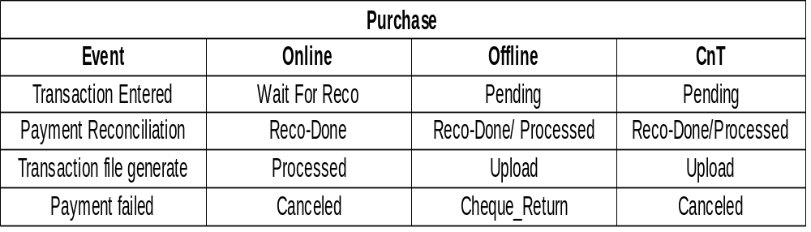
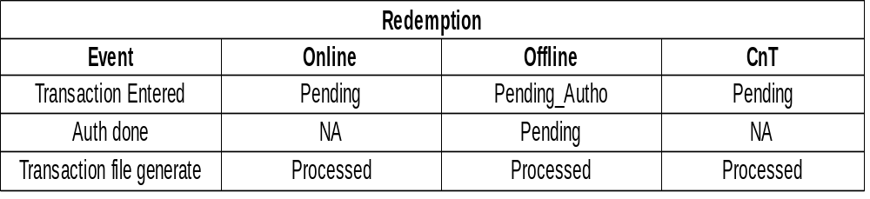
Transaction Status Update – Different modes
PMS - Registration
PMS - Registration

Slide 42
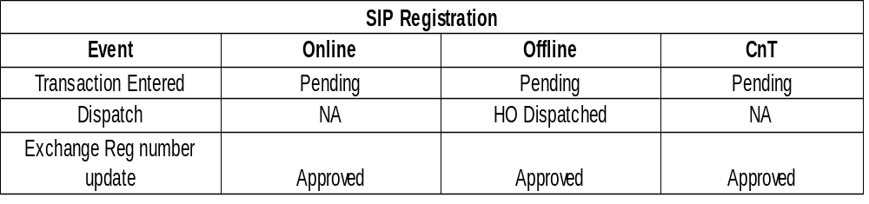
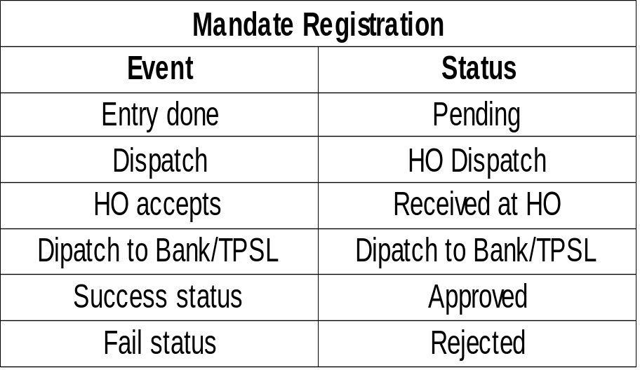
Transaction Status Update – Different modes
PMS - Registration
PMS - Registration

Slide 43
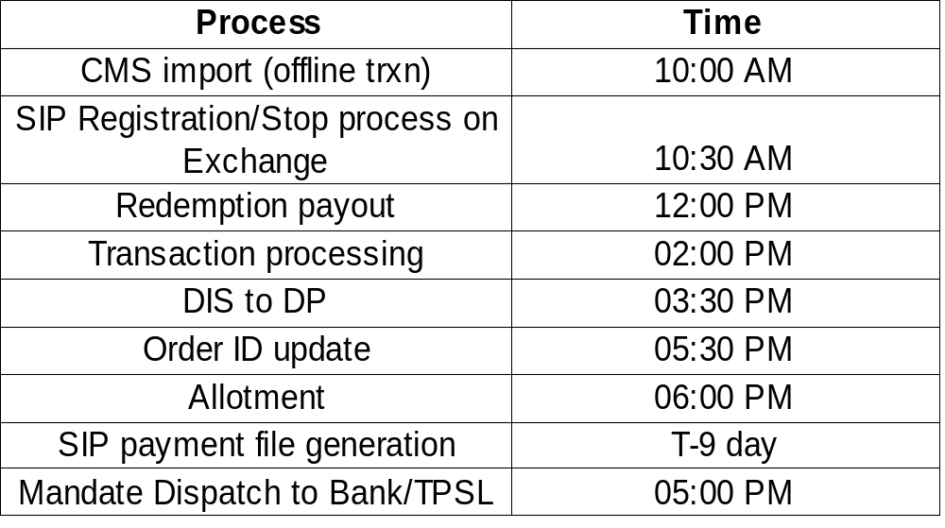
Processing Time
PMS - Registration
PMS - Registration

Slide 44
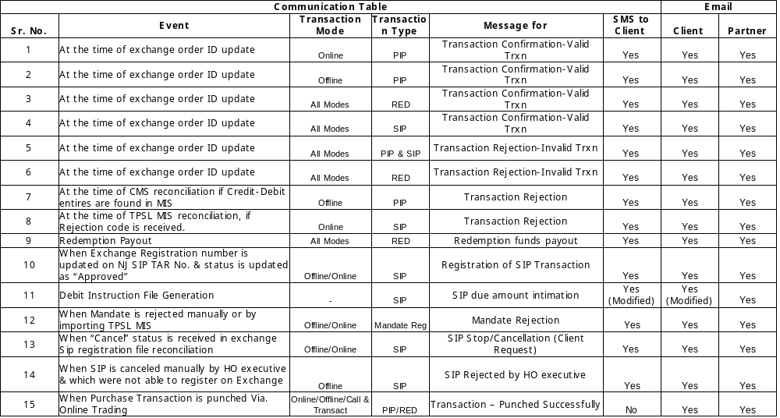
Communication Table

Slide 45
Important Future Projects
PMS - Registration
PMS - Registration
Transaction Payments through Debit Card mode:
    One time registration of Debit card with NJ is required.
    Debit card should be mapped with same bank account which is registered with NJ Trading Account
    At the time of payment, registered Debit card details will be displayed for payment.
    No individual bank tie-up wil be required.
    Fast / secure mode of payment.
Liquid Previous day NAV :
  Transaction submitted in liquid scheme before Cut-off of 12:00 am, will be processed on previous NAV by Exchange.
  Client cut-off 11:30.
  Will be offered to online & Call & Transact mode.

Slide 46
Important Future Projects
PMS - Registration
PMS - Registration
Cash Segment Launch :
  NJ will offer Cash Segment transaction platform to its client.
  Offered through Online / Call & Transact
ETF SIP :
  ETF (Exchange Traded Fund) are the Index fund & are part of Cash Segment
  Normally gold ETF are very popular for investment. NJ will offer SIP in ETF
Other Offering :
Liquid Previous day NAV, NRI Transactions, Minor transaction acceptance.

Slide 47
Important Future Projects
PMS - Registration
PMS - Registration
Other Payment modes:
    Paments through NEFT/RTGS will be allowed for Non online bank clients
    Mobile payments along with mobile wesbite to be offered.
Switch / STP Transaction :
  In order to capture all transaction types we are designing system to offer Switch/STP transactions to client. NJ will be first to offer Switch/STP Transaction faciliy on Exchange. This will enable client to Switch accross AMCs.
  This will be part of NJ's offering, client will give a single Switch transaction but will be executed on Exchange as a Redemption & Purchase transaction
  STP transactions will be auto trigerred in NJ system on STP date selected by client.

Slide 48


